Slide 1


A SHARED PASSION
Faith & Fundraising
Missions exist to transform the lives and hearts of people. Inspired by Jesus and a history of Christians taking action for the wellbeing of their cities.
We share your passion for transformation and are inspired by a selection of gospel stories that provide insight and direction in how we raise money.
Together we can bring insight, grace, and change to both the people you serve, and the donors who join us on the journey.

Slide 2
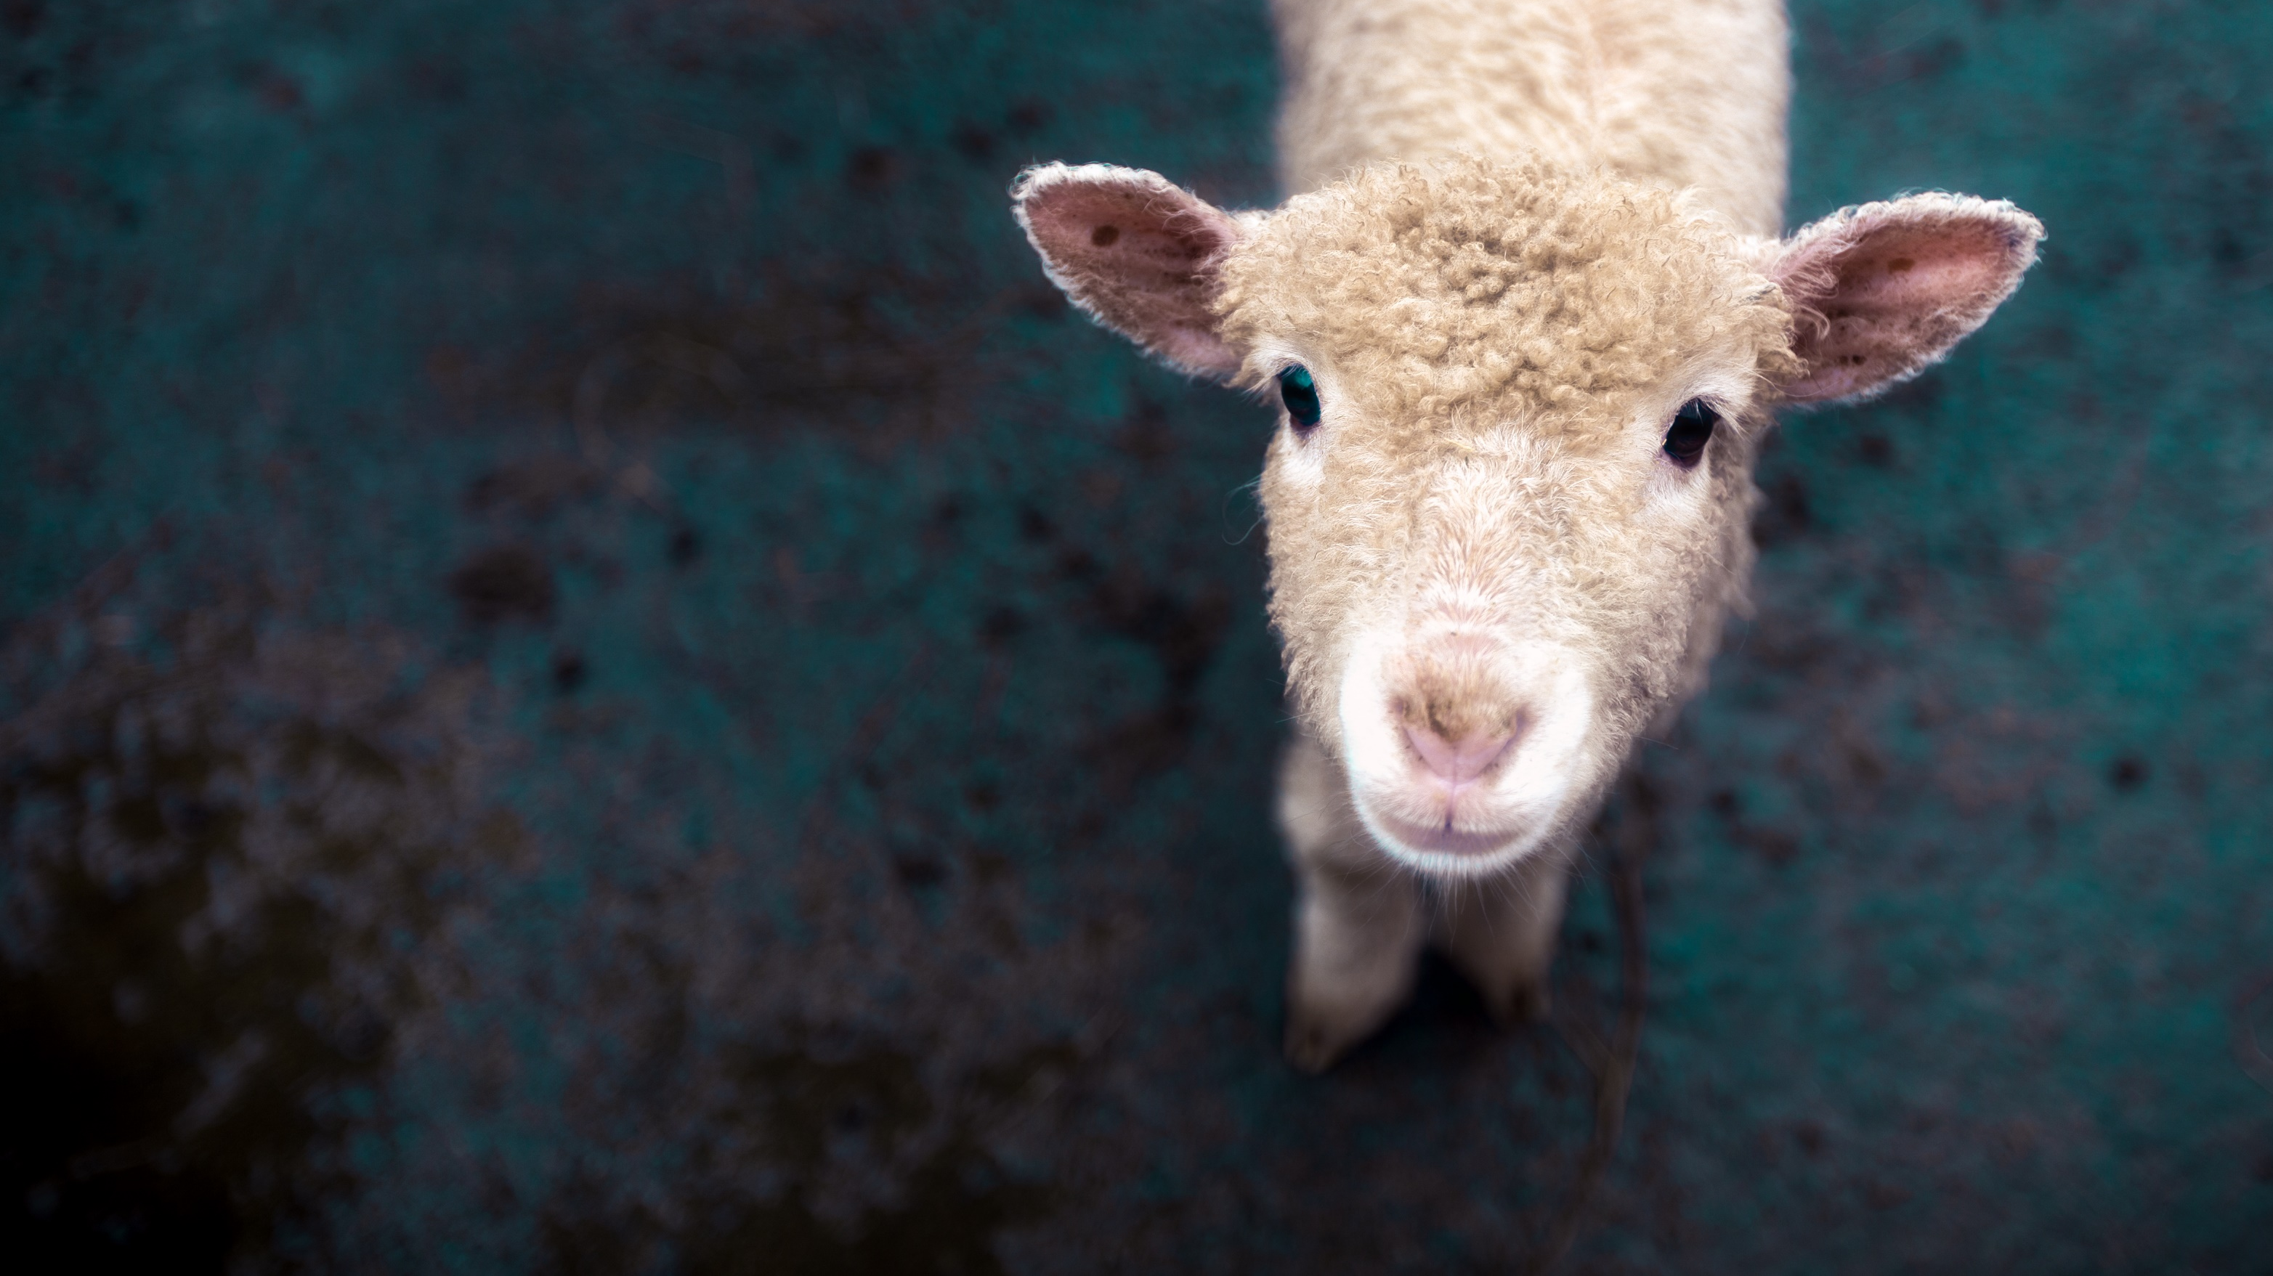
AN INVITATION TO GIVE
An invitation for all to participate. At Jesus’ birth, both the wealthy and accomplished wisemen were drawn by the star and angels announced the birth to lowly shepherds nearby. Successful fundraising calls all to celebrate the impact of giving.
Luke 2:8-21, Mathew 2:1-12 Birth of Jesus

Slide 3
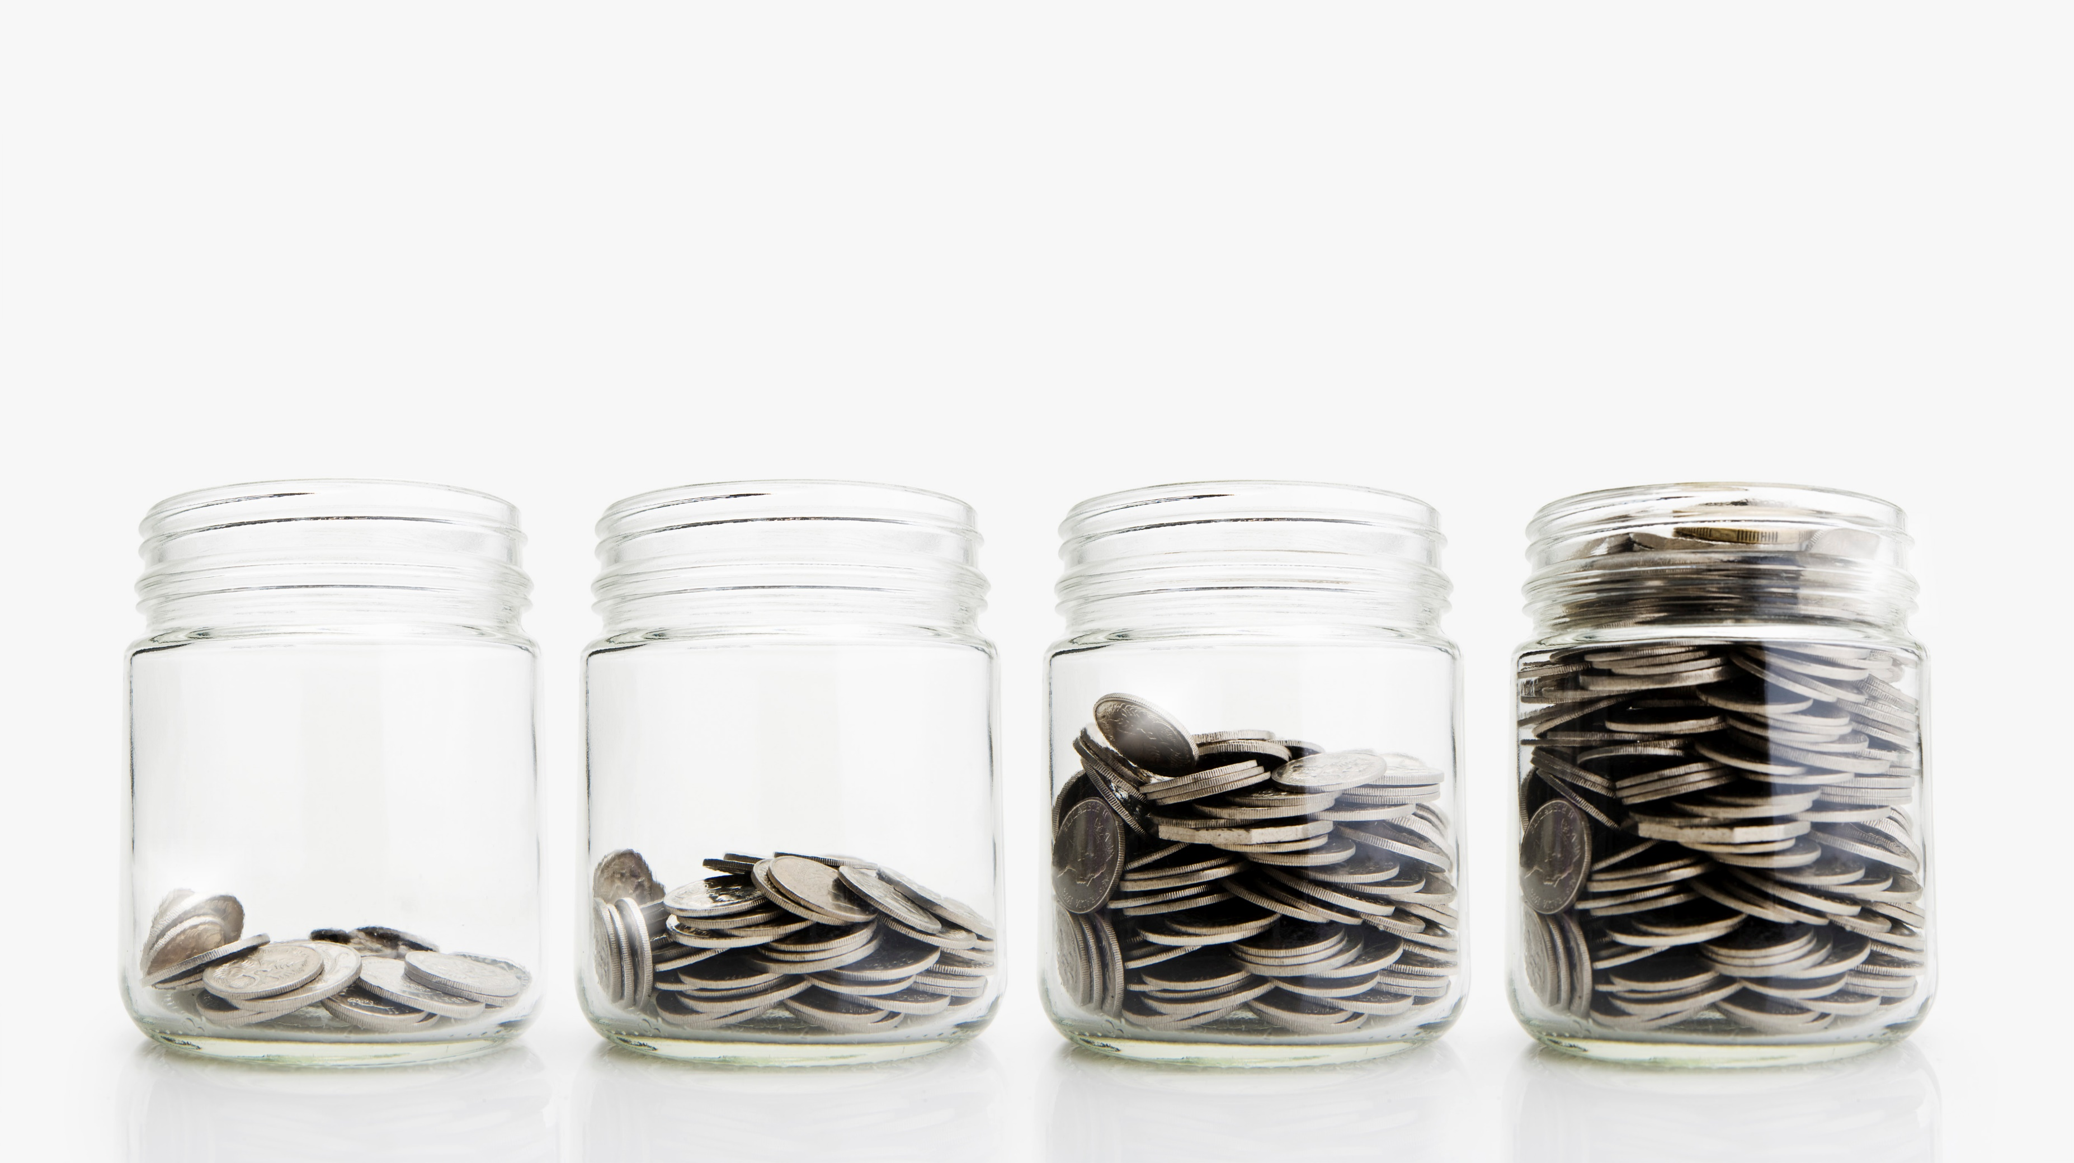
ALL GIFTS MATTER
The collective strength of regular donors drives mission. Sustainability and growth is driven by a growing community of support, from the smallest to largest gift. All are called to participate in the Kingdom of God
Mark 12:42 The Widow’s Mites

Slide 4
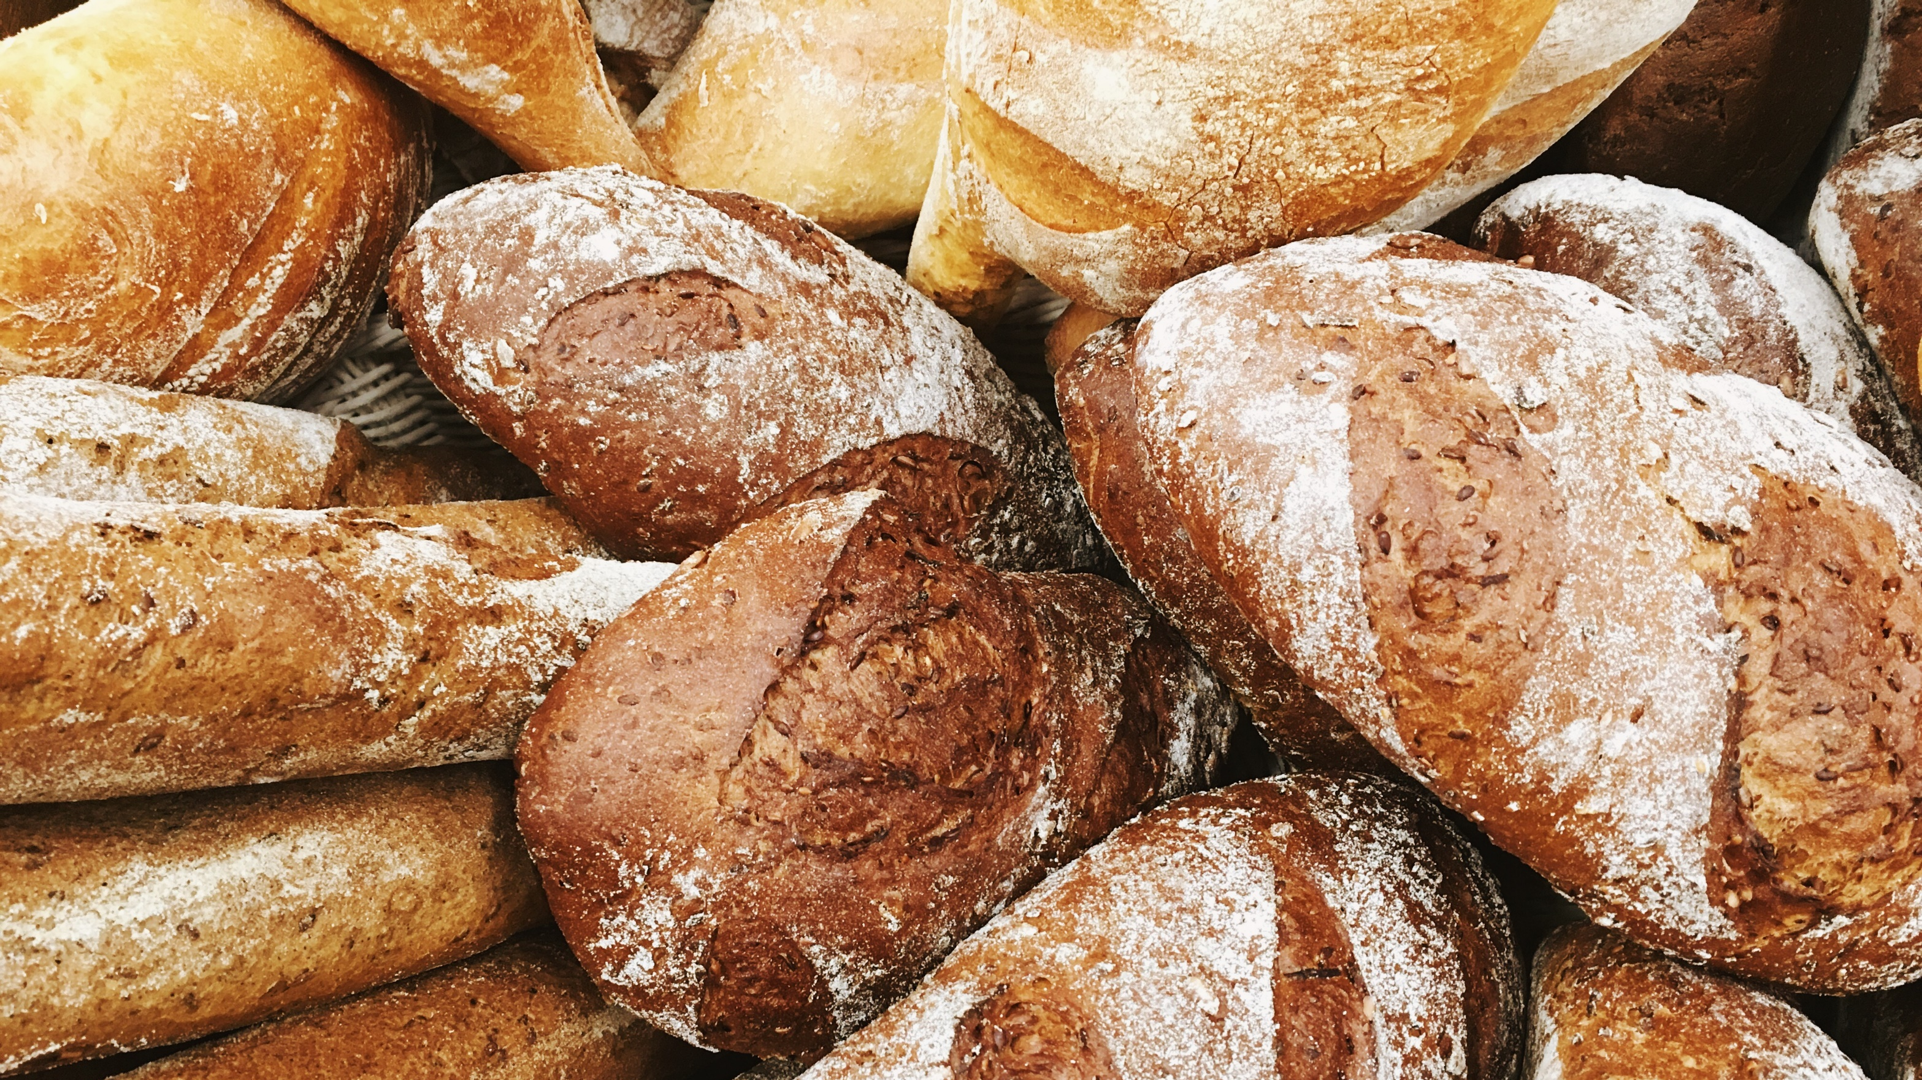
THE POWER OF A SINGLE GIFT
The power of a single gift multiplied. It is the multitude of donors who create a sustainable impact. One donor might feed a family, but collectively they feed a community.
Mathew 14:13-21 Feeding of the Multitude

Slide 5
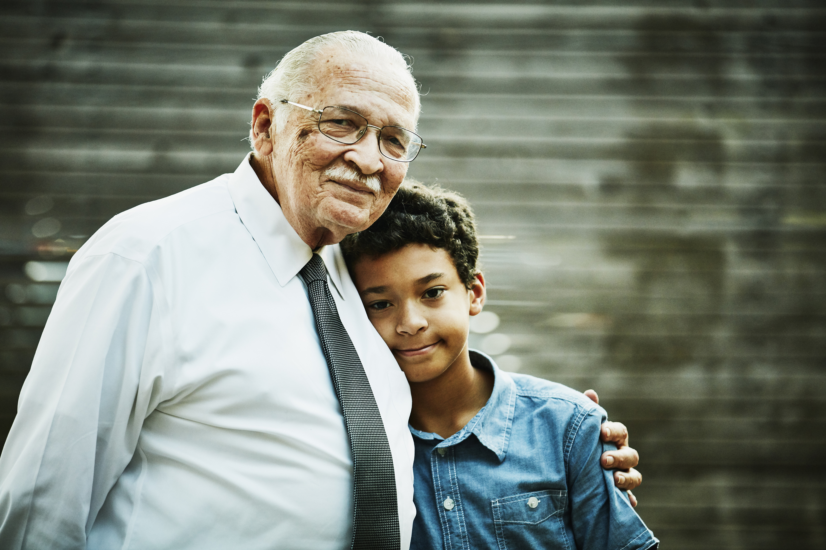
AN INVITATION TO BE CHANGED
Giving is not just financial, it is transformative. The act of giving has a positive impact on how a person sees themselves and the world around them, connecting the donor to their community and world. God doesn’t want generosity from us, but generosity for us.
Luke 19:1-10 Zacchaeus
Notes:
Not generosity from us, but generosity for us.

Slide 6

GIVING CAN BE INTRUSIVE
We live busy lives and must attend to our needs as people, so sometimes we need a nudge (or a hole in the ceiling) to remind us that we have the power to change a person’s life.
Mark 2:3-11 The Healing of the Paralyzed Man

Slide 7

THE PAST IS NOT A LIMIT
At the heart of our work is the unshakable belief that donor’s can provide the resources to help a person transform their circumstances and in turn make an impact in the world.
John 4:1-42 The Story of the Samaritan Woman

